Slide 1
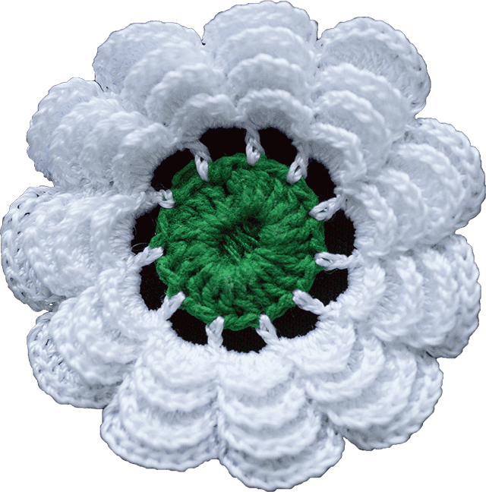
Mother and Flower of Srebrenica
A poet once said: “...a mother's love, even if expressed through tears, is the only sincere and true love that always gives us strength….”

Slide 2
Introduction
Your Worship Mayor Brown, Members of Council and others present here, good morning. My name is Alisa Durak, I am a recent graduate from TMU and I am direct descendant of Bosnia and Herzegovina. I am honoured to be here today to talk about the Srebrenica Genocide.
Thank you for your kindness, allowing us to speak at City Hall, as well as for sparing your time from your busy schedule to join us today. We view this event as a way to honour and remember the victims of the Srebrenica Genocide, 30 years after it occurred.
This year it is the 30th anniversary of that tragic event started on July 5th in the city of Windsor, ON and continued across Canada.
Happenings in Srebrenica were earlier, now are, and are going to be great inspiration for poets, writers and other artists not only in Bosnia but worldwide.
Just for your information, Srebrenica in English means Silver City.

Slide 3
Purpose of the Meeting
As this year marks the 30th anniversary of the Srebrenica Genocide (July 11, 1995), the Bosnian Canadian Community, particularly survivors respectfully request that government of Brampton city stands in solidarity with us by issuing a public Proclamation to mark this solemn event in the recent history of Bosnia and Herzegovina.
The Bosnians in Brampton expect that the government of Brampton city through educational system proactively supports the process of learning and preserving the truth about the Srebrenica Genocide.
The Bosnians in Brampton would appreciate it, if Brampton city would allow designated park area where a monument would allow the annual gathering of Bosnians and others to show deserved respect to all who perished in the Srebrenica Genocide. The project design for such monument will be submitted for approval by following current established procedures for it.
The Bosnians in Brampton would be more than happy, if any form of a future street in Brampton carries name that have Srebrenica word in it.

Slide 4
What Happened in Srebrenica
The Srebrenica Genocide happened on July 11th 1995 and it is the most severe genocide on European soil since the Holocaust
The Srebrenica Genocide, is perpetrated by Bosnian Serb forces in July 1995 within the "United Nations protected area" of Srebrenica, Bosnia and Herzegovina.
As a reminder, in 1993, the UN passed Resolution 819, declaring Srebrenica a “safe zone.” Thousands of Bosnians fled there seeking protection, placing their trust in the UN and its 200 stationed Dutch peacekeepers

Slide 5
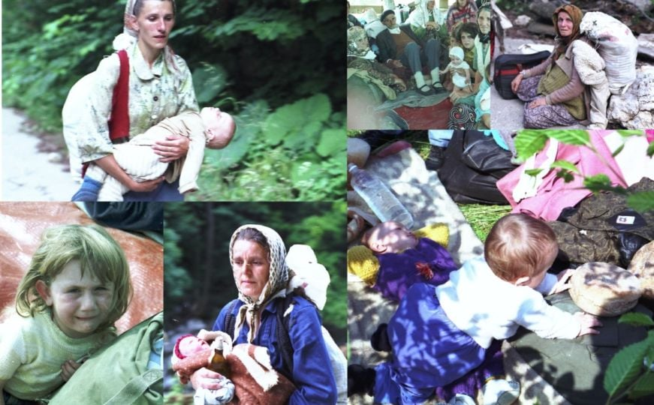

Slide 6
How It Happened
However, the resolution that authorized their deployment did not permit the use of force to defend civilians. In July 1995, Serbian occupying forces led by criminal general Ratko Mladić captured the city while UN troops stood by.
What followed was a cold, calculated, and systematic genocide. Unarmed men and boys were separated from their families and brutally executed within days. Women and girls were placed in camps, where many were raped and tortured.

Slide 7
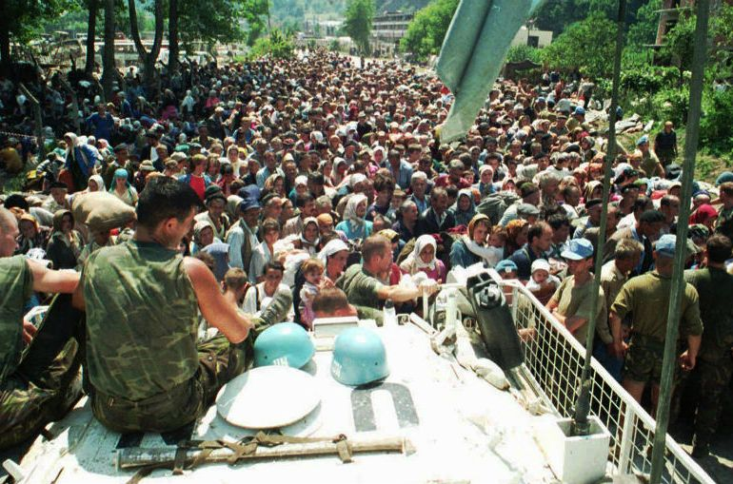

Slide 8
Numbers Killed in Srebrenica
To conceal the crimes, bodies were buried in mass graves, then later exhumed and reburied in secondary and tertiary graves in an attempt to destroy the evidence.
There are currently 8,372 names on the preliminary list of murdered Srebrenica residents, and over 12,000 people are still listed as missing. New mass graves are still being discovered to this day.
Every year on July 11, newly identified victims are laid to rest at the memorial cemetery in Potočari, near Srebrenica city.

Slide 9
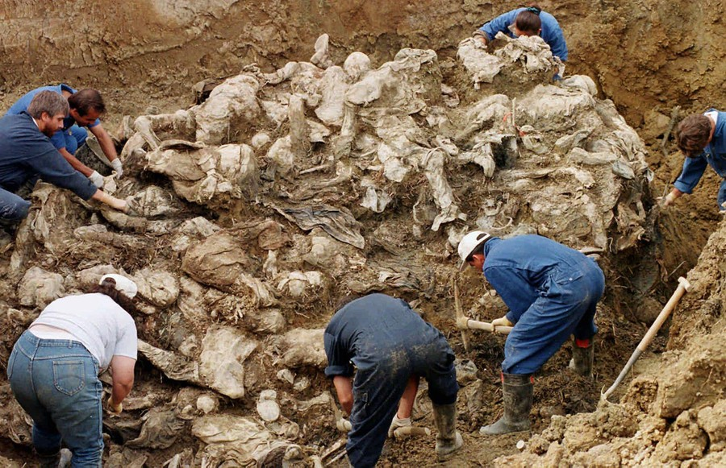

Slide 10
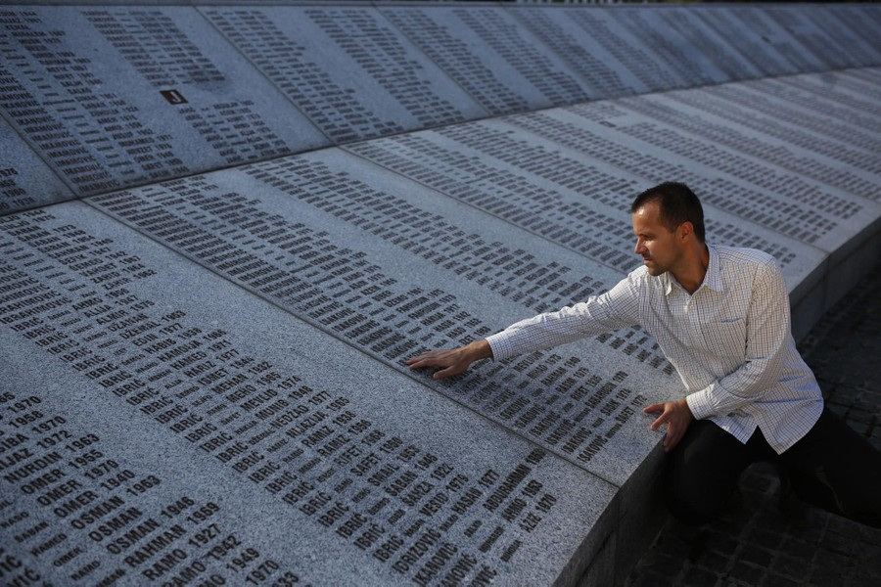

Slide 11
International Community Activities During the End of 20th Century
Srebrenica remains one of the darkest and most shameful chapters of the 20th century - a symbol of the international community’s failure, and a lasting reminder of the need to stand firmly against genocide, wherever it may occur.
UN made "serious errors of judgment" in Srebrenica and that highlighted the UN's inadequacy in peacekeeping during wars.
The international community needs to learn from Srebrenica to improve the UN's ability to prevent genocides in the future.
Despite its promise, the phrase “never again” feels broken, as genocides and mass atrocities continue across the globe.

Slide 12
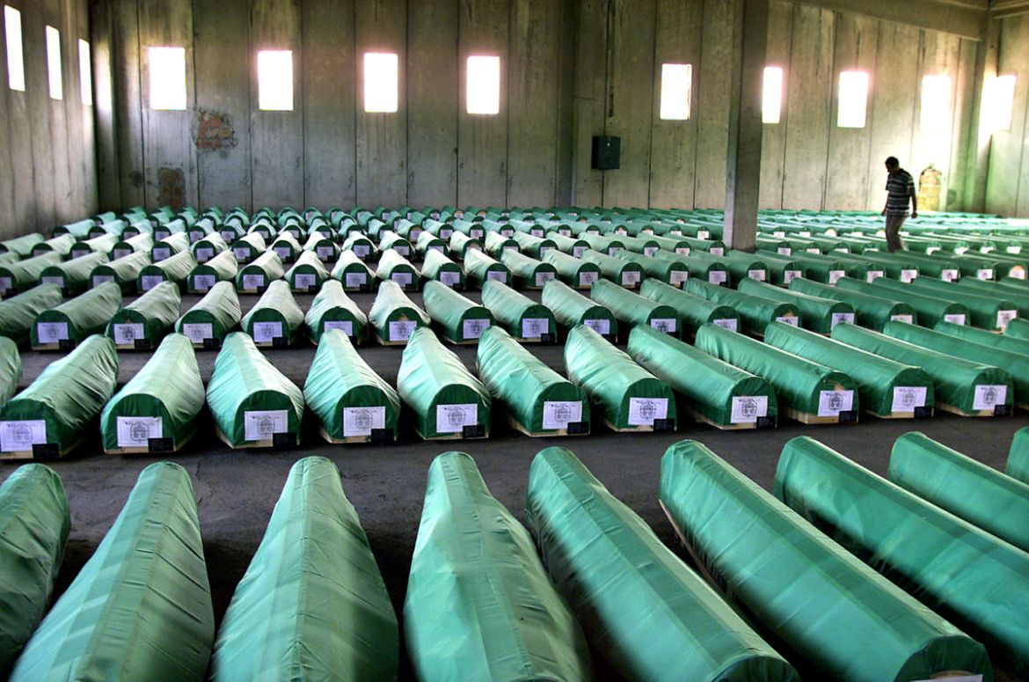

Slide 13
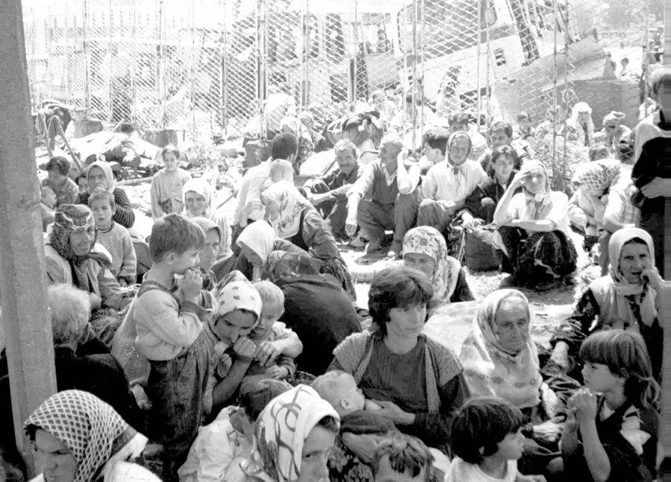

Slide 14
Canadian Role
Further, Canada has taken commendable steps to recognize the Srebrenica Genocide and to lead efforts in preserving the memory of its victims, both domestically and internationally.
Notably, in 2010, the Canadian Parliament established Srebrenica Genocide Remembrance Day, and in May 2024, Canada co-sponsored the Resolution A/RES/78/282 at the UN General Assembly.
Canada has consistently demonstrated its friendship and alliance with Bosnia and Herzegovina and its people. This is reflected in the significant Bosnian diaspora residing across Canada, many of whom are survivors of the Srebrenica Genocide.

Slide 15
International Community Activities
During the End of 21st Century
On 23 May 2024, the United Nations General Assembly adopted Resolution A/RES/78/282, officially designating 11 July as the International Day of Reflection and Commemoration of the 1995 Genocide in Srebrenica, to be observed annually. The resolution also established the UN Outreach Program on the Srebrenica Genocide, reinforcing global commitment to memory, education, and prevention.
This resolution stands as proof that the world has not forgotten Srebrenica. It is a clear message to survivors, families, and future generations that the victims will be remembered, their suffering acknowledged, justice pursued, and the truth to be preserved.

Slide 16
Conclusion #1
Observing July 11, affirms the importance of acknowledging the rulings of international tribunals as an essential step toward justice, reconciliation, and the prevention of future crimes such as genocide, war crimes, and crimes against humanity.
By remembering and honouring the victims of Srebrenica, we become their voice. In doing so, we reject denial, uphold truth, and stand firmly against hatred and genocide. Our remembrance is not just an act of mourning - it is a commitment to justice and a call to protect future generations from similar atrocities.

Slide 17
Conclusion #2
We would be grateful if your government could consider the following:
a) issuing the mentioned Proclamation to mark Srebrenica Genocide, b) supporting the process of learning about the Srebrenica Genocide, c) preliminary approving building a small monument in a designated park area d) planning to name any form of a future street by name “Srebrenica”.
The Srebrenica flower is a symbol of remembrance the Srebrenica Genocide. Its eleven white petals represent the innocence of the victims and the date of the genocide - 11 July 1995 - while the green center symbolizes hope for a better future.

Slide 18
Conclusion #3
Your presence here today means a lot to us. I thank you for your time and efforts to come to this gathering.
On behalf of the Bosnian Community in Brampton, we extend our heartfelt gratitude for your unwavering support and look forward to your continued cooperation.
If you have any comments or question, please let us know. We would be more than happy to answer.
Thank you very much!

