Slide 1

Honouring the Srebrenica Genocide
– 31 Years Later
A poet once said: “...a mother's love, even if expressed through tears, is the only sincere and true love that always gives us strength….”
July 11, 1995
8,372…

Slide 2
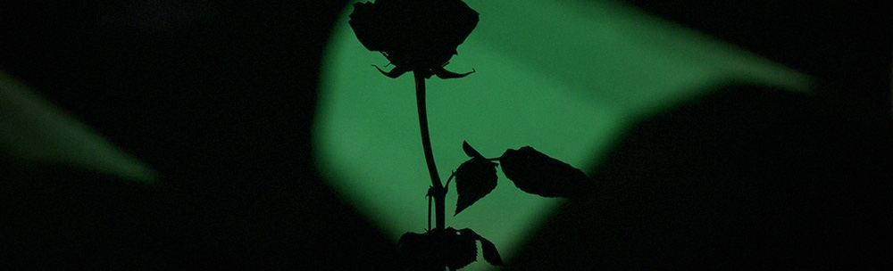
Purpose:
Honour the victims and survivors of the Srebrenica Genocide, 31 years later.
Thank the City of Toronto for its continued recognition and solidarity.
Explore opportunities for education, remembrance, and genocide prevention initiatives in Toronto schools.
Discuss opportunities for long-term commemorative partnerships with the City of Toronto.

Slide 3
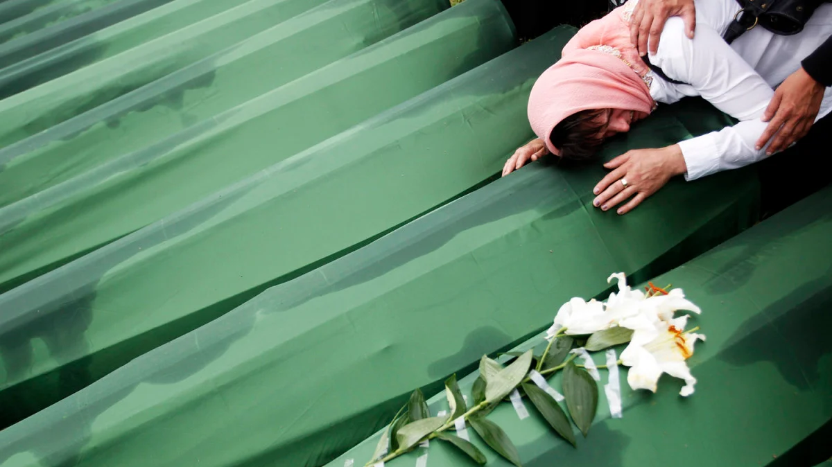
Understanding the Srebrenica Genocide
Most Severe Genocide in Europe Since WWII
Over 8,000 Bosniak men and boys were systematically executed.
This atrocity is recognized as the worst mass killing in Europe since the Holocaust.
UN-Declared Safe Zone
In 1993, the UN designated Srebrenica a “safe zone” under Resolution 819.
Civilians fled there seeking protection, trusting the international community.
Failure to Protect
Despite the presence of 200 Dutch UN peacekeepers, the town fell to Bosnian Serb forces.
The genocide occurred within a UN-protected area, highlighting a catastrophic failure by the international community.
Targeted Ethnic Cleansing
The genocide was part of a broader campaign of ethnic cleansing against Bosnian Muslims.
Thousands of women, children, and elderly were forcibly displaced.
Global Recognition & Responsibility
The International Criminal Tribunal for the former Yugoslavia (ICTY), International Court of Justice(ICJ), Court of Bosnia and Herzegovina have ruled the massacre as genocide.

Slide 4
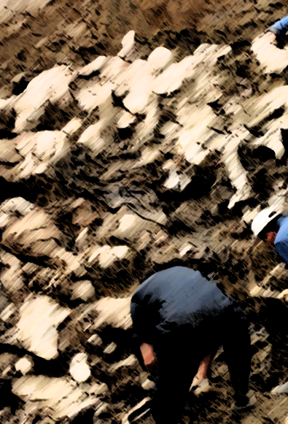
Concealing the Genocide
Victims were buried in mass graves to hide the scale of the genocide.
Bodies were exhumed and reburied in secondary and tertiary sites to destroy evidence.
Resulting in fragmented remains of individuals being found across multiple grave sites, complicating identification and recovery efforts.

Slide 5
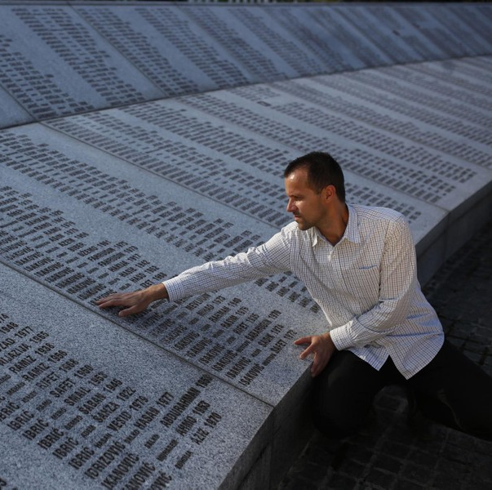
31 Years Later
8,372 identified victims.
Over 1,000 individuals remain missing to this day.
New mass graves are still being uncovered.
Every July 11, newly identified victims are laid to rest at the Potocari Memorial Cemetery, near Srebrenica.

Slide 6

Canada’s Role
National Recognition: In 2010, the Canadian Parliament established Srebrenica Genocide Remembrance Day.
International Leadership: In May 2024, Canada co-sponsored UN Resolution A/RES/78/282, officially recognizing July 11 as the International Day of Reflection and Commemoration of the 1995 Genocide in Srebrenica.
A Strong Ally: Canada has consistently shown solidarity with Bosnia and Herzegovina, supporting survivors and remembrance efforts.
A Connected Community: Canada is home to a significant Bosnian diaspora, including many Srebrenica Genocide survivors.

Slide 7

UN Resolution and Commitment
Official Commemoration
On May 23, 2024, the UN General Assembly adopted Resolution A/RES/78/282.
  Designating July 11 as the International Day of Reflection and Commemoration of the 1995 Genocide in Srebrenica.
Global Education & Outreach
  The Resolution established the UN Outreach Program on the Srebrenica Genocide - focuses on education, remembrance, and prevention.
A Message to the World
  Affirms that Srebrenica will not be forgotten.

Slide 8

The Importance of July 11th
Acknowledging Justice
Honouring the Victims
A Commitment to the Future

Slide 9
Community Requests for Recognition and Remembrance
Continuing to issue a formal proclamation.
Supporting educational initiatives.
Approving the creation of a small memorial monument.
Considering the naming of a future street

Slide 10
Thank you for your attention

